Slide 1
Constraint cosmological parameters of flat-LCdM model using hubble parameter measurements
Project 1

Slide 2
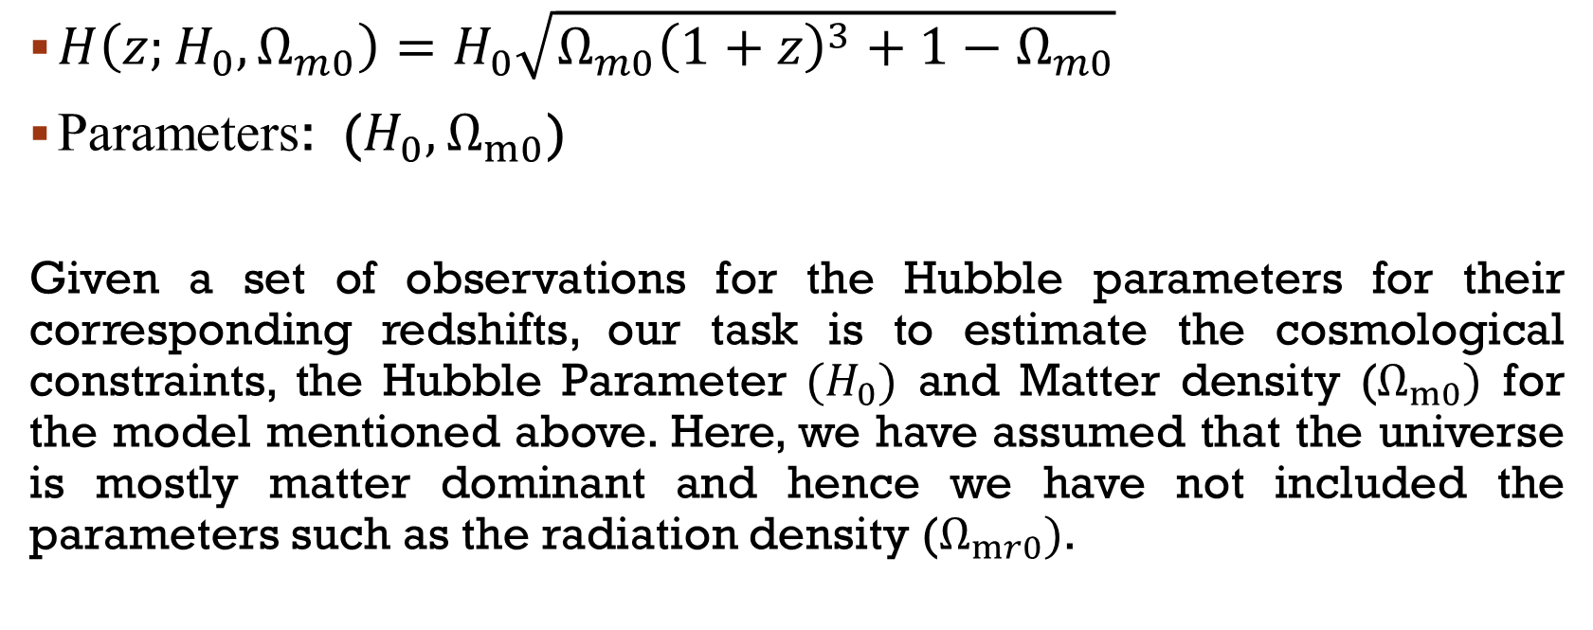
Model
$H\left(z;H_{0},Ω_{m0}\right)=H_{0}\sqrt{Ω_{m0}{\left(1+z\right)}^{3}+1−Ω_{m0}}$
Parameters: ($H_{0},Ω_{m0}$)
Given a set of observations for the Hubble parameters for their corresponding redshifts, our task is to estimate the cosmological constraints, the Hubble Parameter $(H_{0})$ and Matter density ($Ω_{m0})$ for the model mentioned above. Here, we have assumed that the universe is mostly matter dominant and hence we have not included the parameters such as the radiation density ($Ω_{mr0})$.

Slide 3
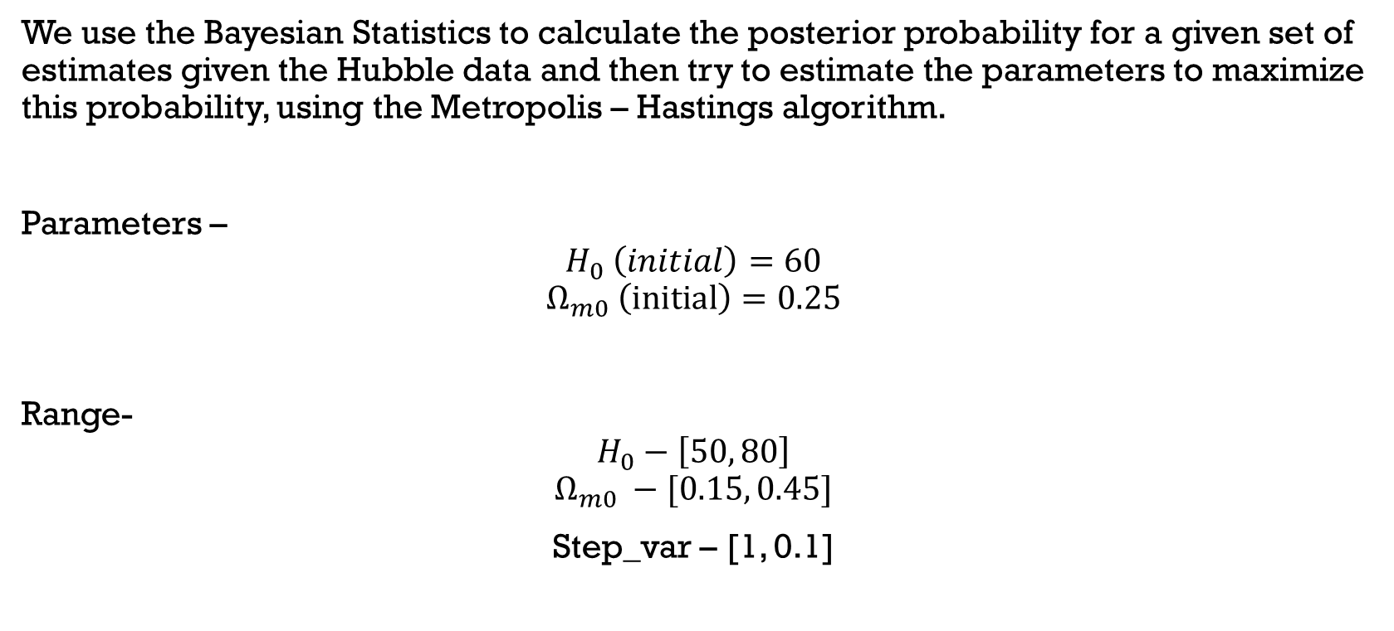
Summary
We use the Bayesian Statistics to calculate the posterior probability for a given set of estimates given the Hubble data and then try to estimate the parameters to maximize this probability, using the Metropolis – Hastings algorithm.
Parameters –
$$H_{0} \left(initial\right)=60$$
$$Ω_{m0} \left(initial\right)=0.25$$
Range-
$$H_{0}−\left[50, 80\right]$$
$$Ω_{m0} −[0.15, 0.45]$$
Step_var – [1, 0.1]

Slide 4
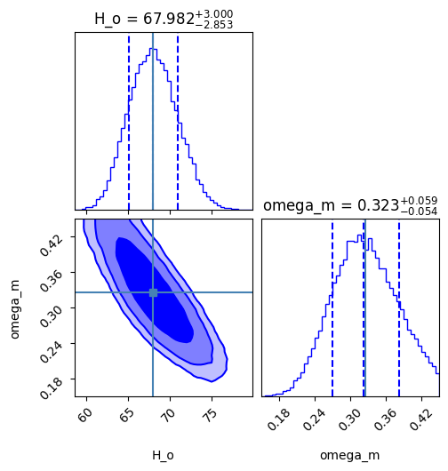
Contour Plot

Slide 5
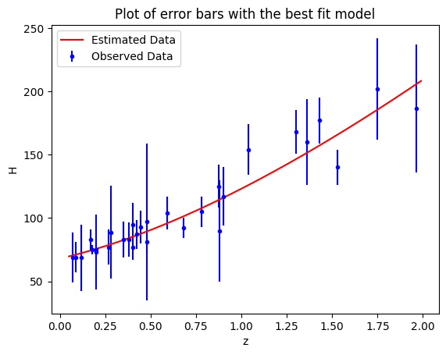

Slide 6
Thank You

